Slide 1
A Practical Introduction to Crocoddyl
17.03.2020 Julian Eßer

Slide 2
Overview
Introduction
Workflow & Example
Modeling Bipedal Walking
Preliminary Results with RH5

Slide 3
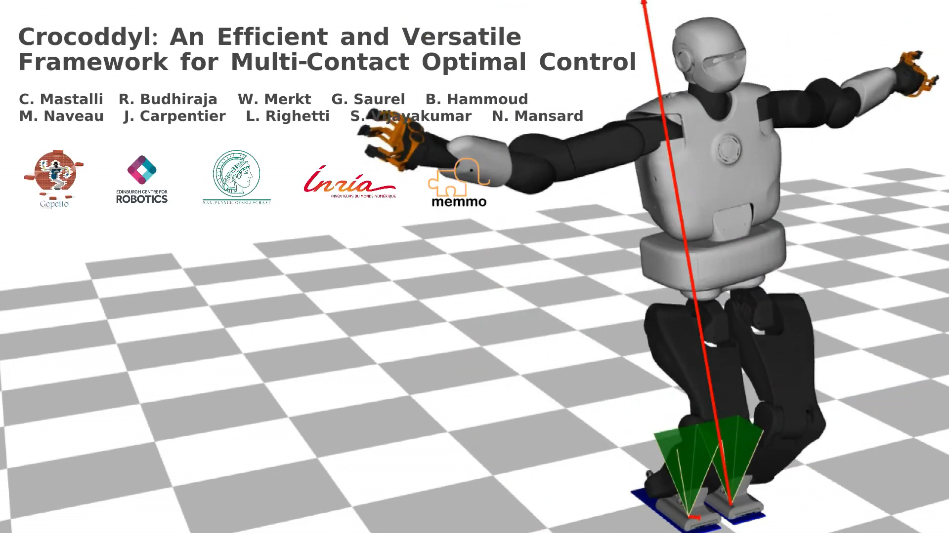

Slide 4
Introduction
Optimal Control library for contact sequences
Input: Single/multi-shooting problem
Output: Optimal trajectories & control policy
DDP based optimal control solvers
C++ library with python bindings
Dependencies:
Pinocchio (dynamics + analytical derivatives)
Gepetto (3D visualization)

Slide 5
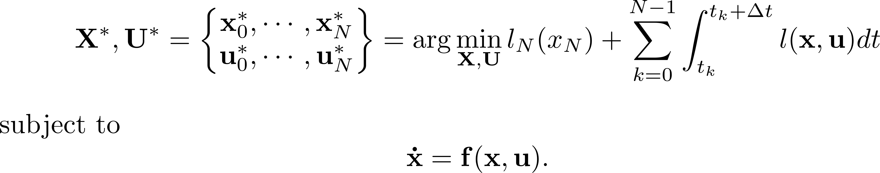
Introduction
Focus on multi-contact optimal control problems
Goal:
Optimal Trajectories +
Optimal Control Inputs
Terminal knot
Running knots
{Input torques, contact forces}
Notes:
Reduce complexity: Not searching for optimum for all x, but for defined initial configuration x0 (reduce complexity)
Control u=(tau,lambda): Input torques+contact forces
Subject to system dynamics

Slide 6
Workflow
Load robot model
For each knot: Define action model
Add differentiation/integration routines
Setup shooting problem
Apply solver
Action Model :=
{Dynamics + Costs} for one knot
Shooting Problem :=
{N Running Models + Terminal Model}
Notes:
1. URDF, SRDF, Meshes

Slide 7
Action Model: Components
Current State
Cost Model
State/Control
Frame displacements
CoM/CMP
Contact Model
3D/6D contact Jacobians

Slide 8
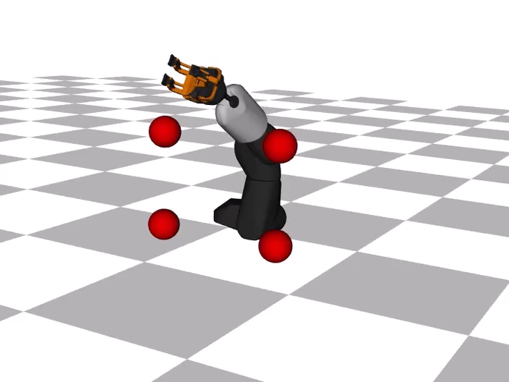
Example: Goal Reaching with Robotic Arm

Slide 9
Modeling Bipedal Walking
Parameterize contact sequence
Define shooting problem - Locomotion phases:
Create individual action models
6D multi-contact model
Cost model (CoM & foot tracking, friction cone, state, control)
Differential & Integration Rules
(Pseudo-) Impulse model
1. Double Support
2. Right Step
3. Double Support
4. Left Step

Slide 10
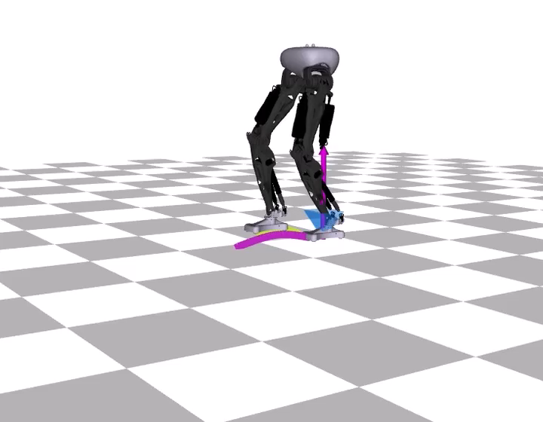
Preliminary Results with RH5
Integrating a simple model
Performing a full gait
Notes:
Model: Serial model of the RH5 legs

Slide 11
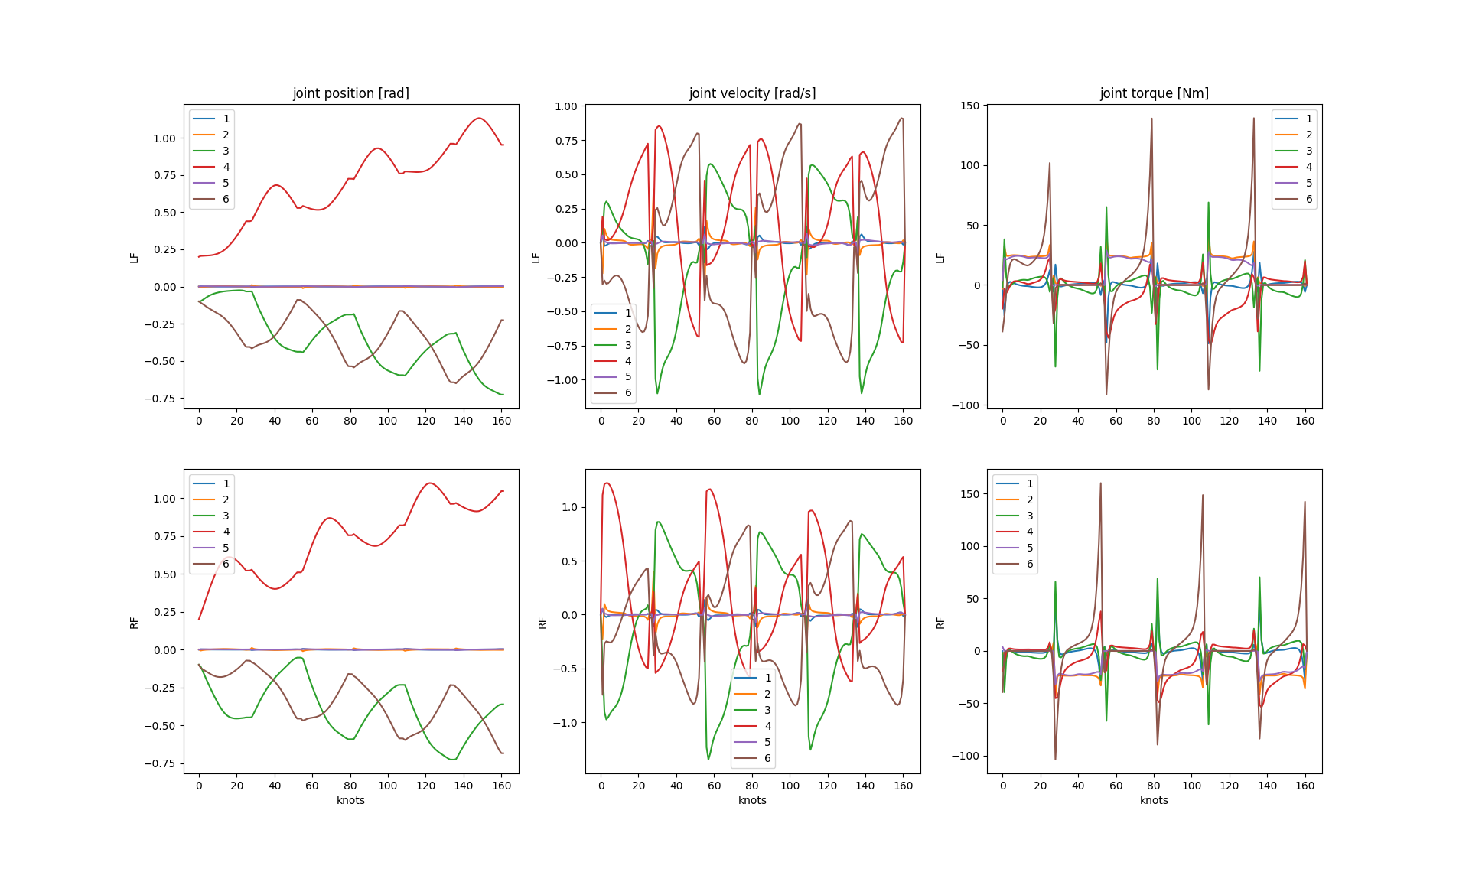
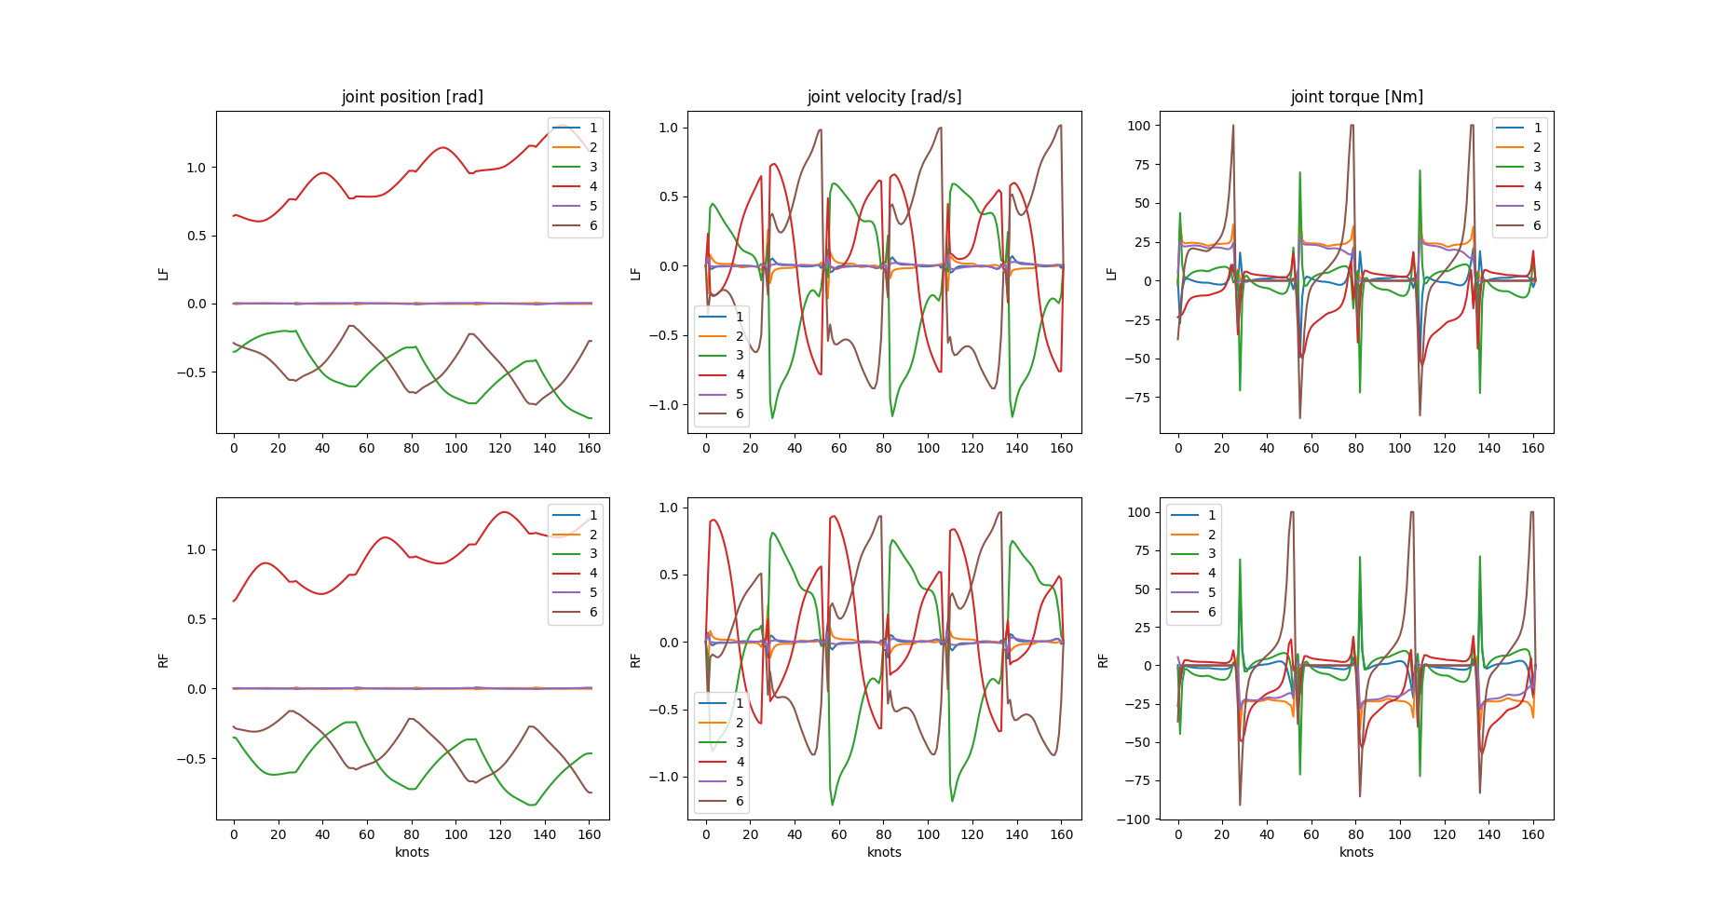
RH5 Analysis: Bounded Input Torques
URDF joint limits
Joint limits reduced by 50 percent

Slide 12
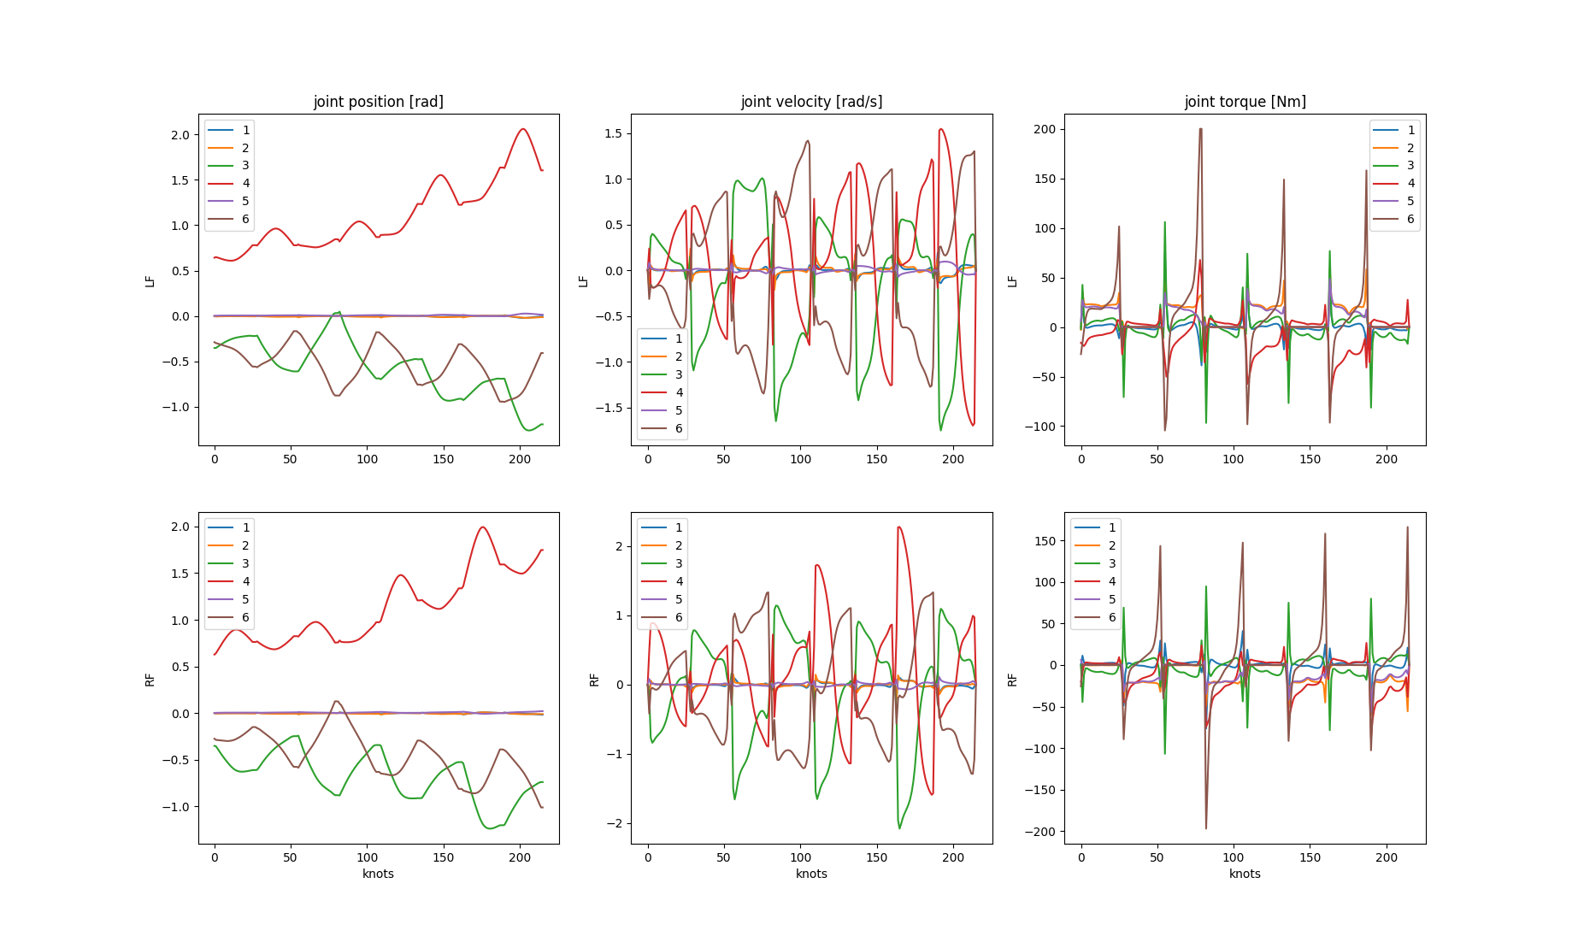
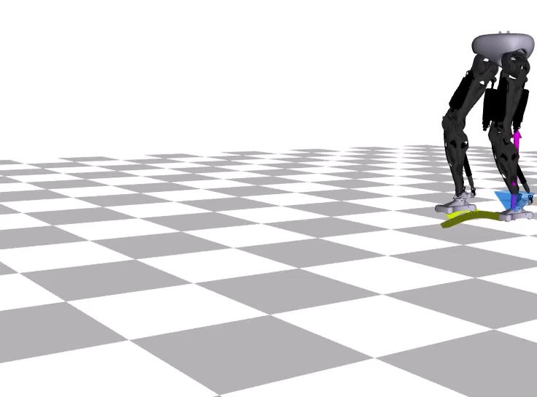
RH5 Analysis: Varying Gait Phases

Slide 13
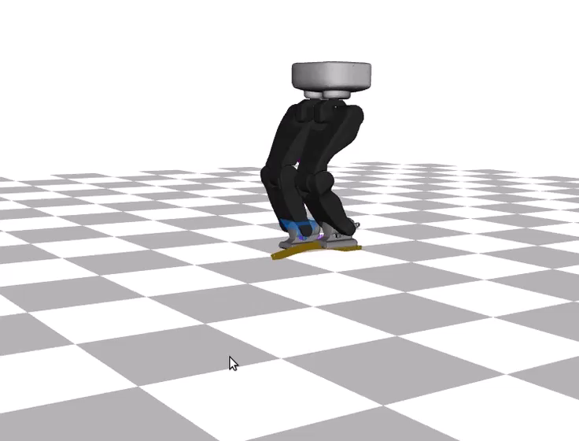
RH5 Analysis: Talos vs. RH5

Slide 14
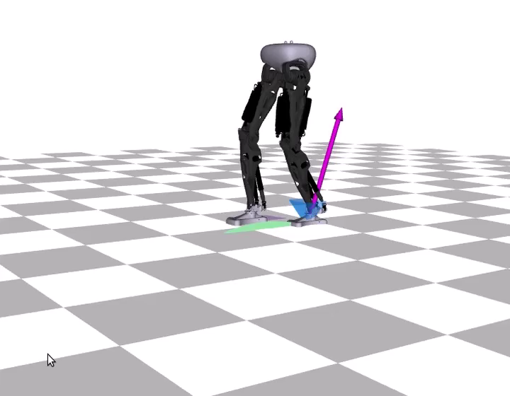
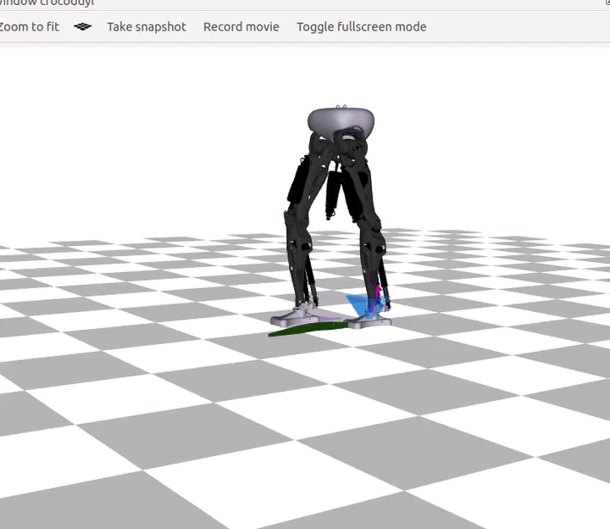
RH5 Analysis: Init Pose Variants
„Sitting“ position
Init near zero configuration
Init at zero configuration

Slide 15
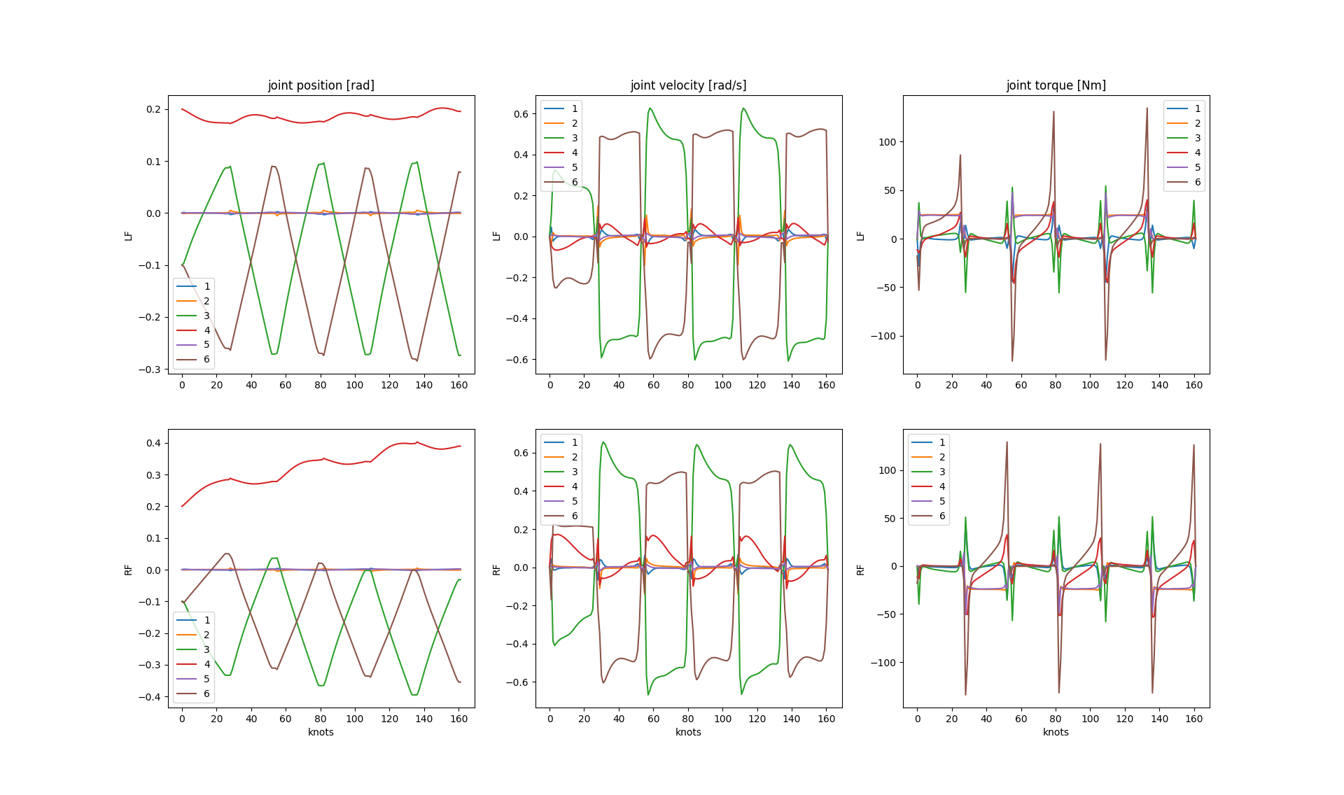
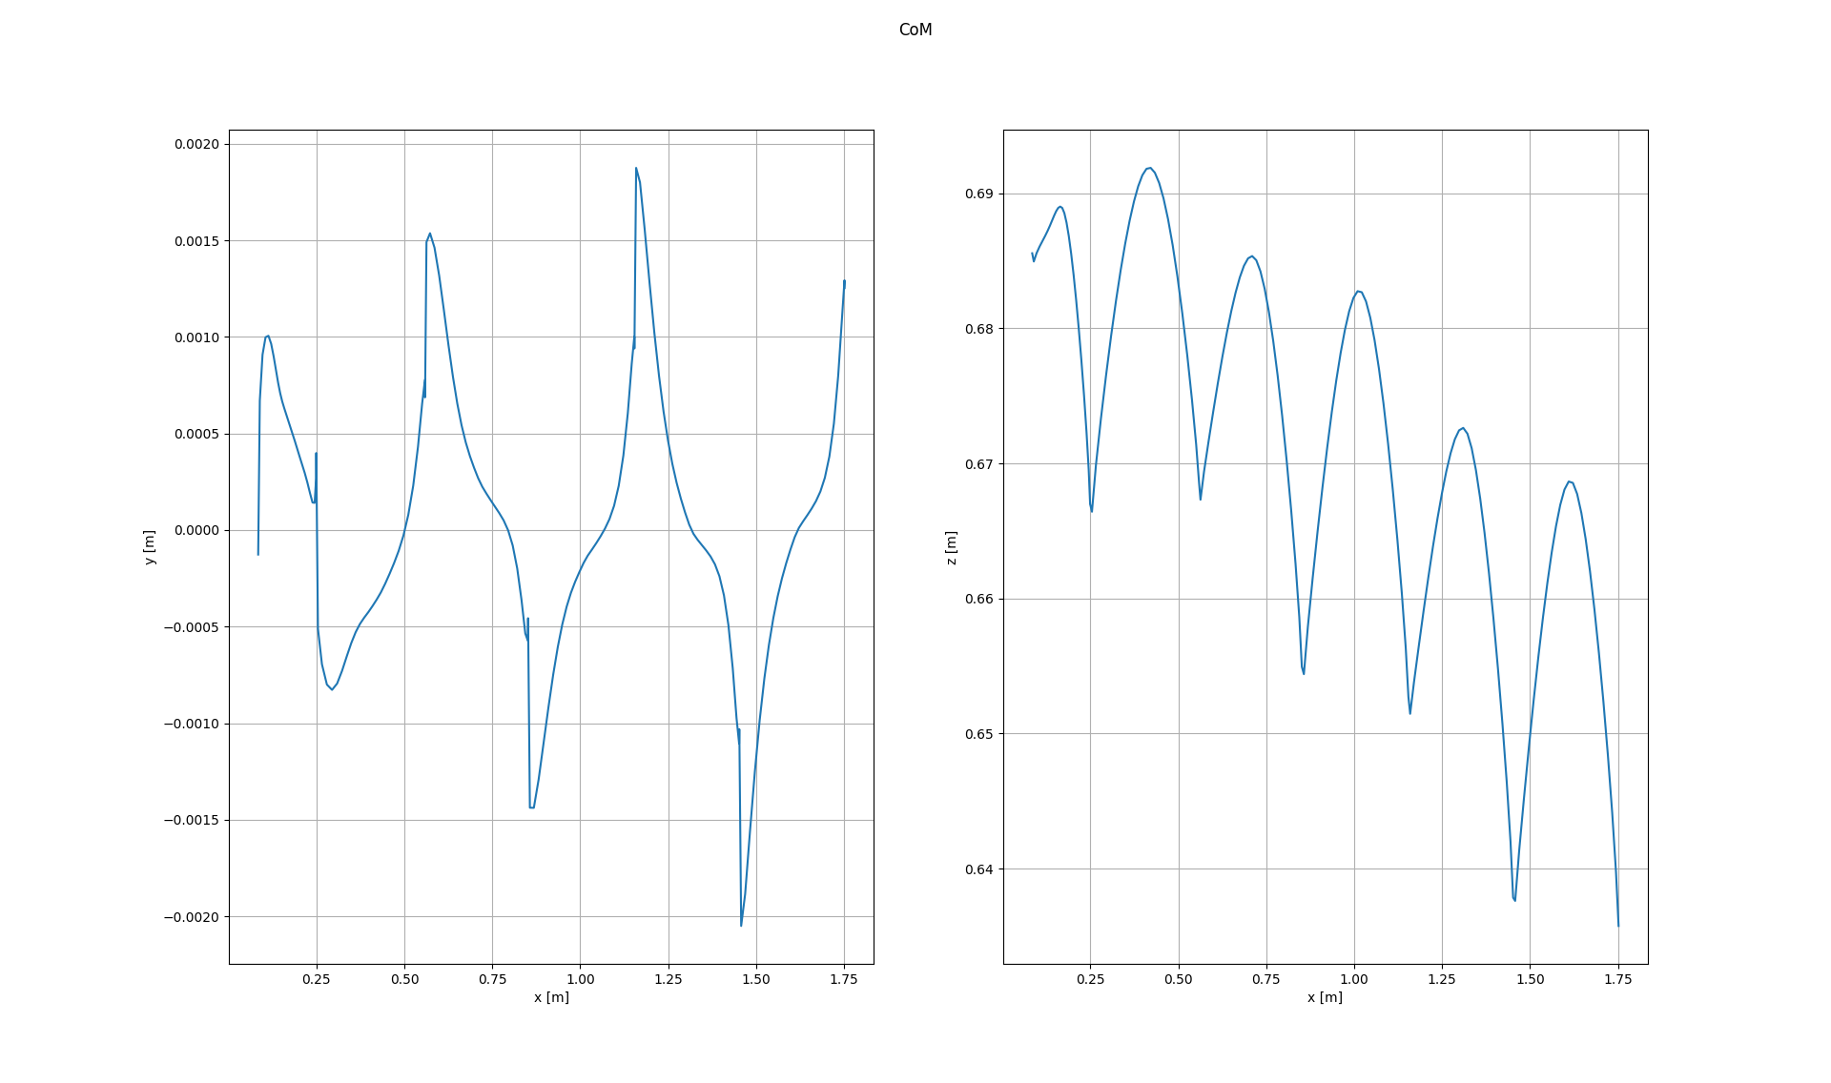
RH5 Analysis: State Periodicity
Approach: Penalize state variations
Next idea: Eq-constrain for terminal state

Slide 16
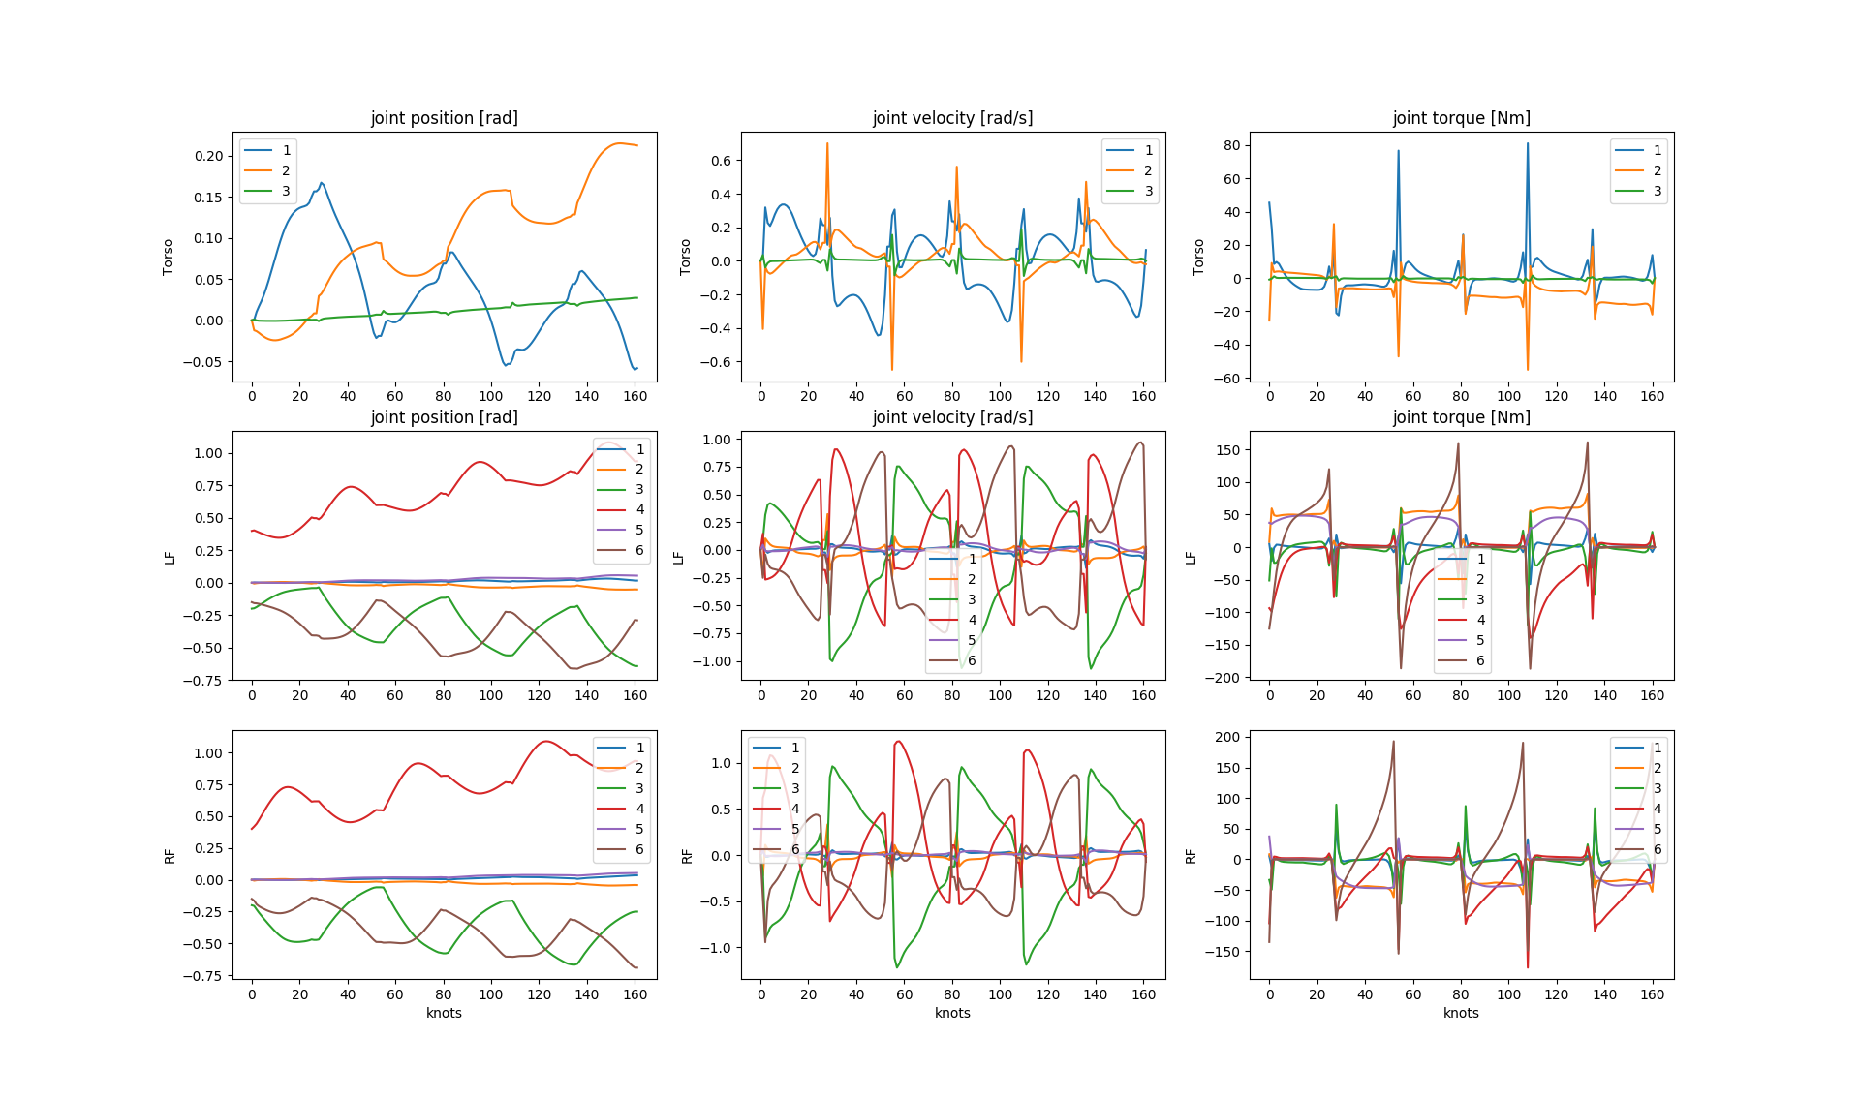
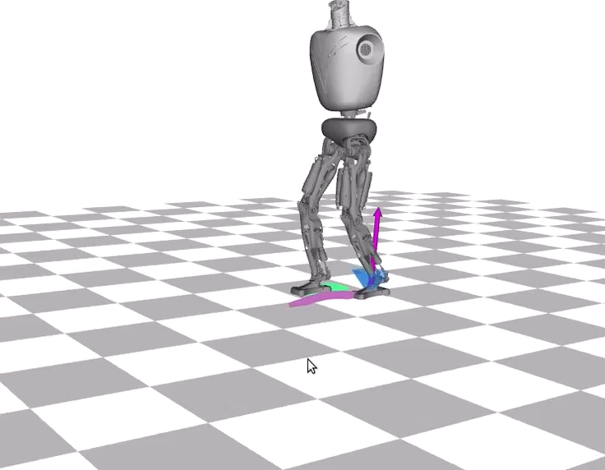
RH5 Analysis: Legs + Torso

Slide 17
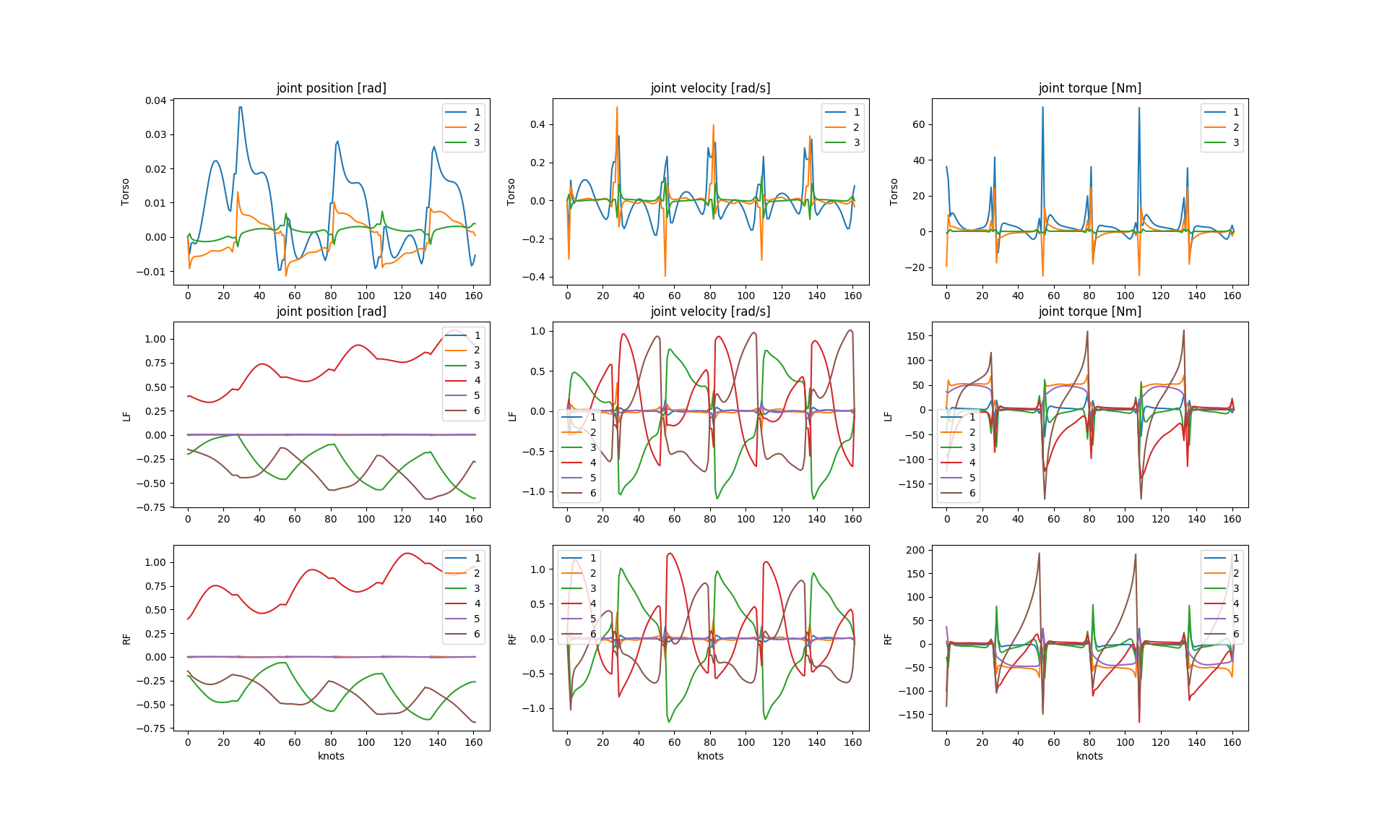
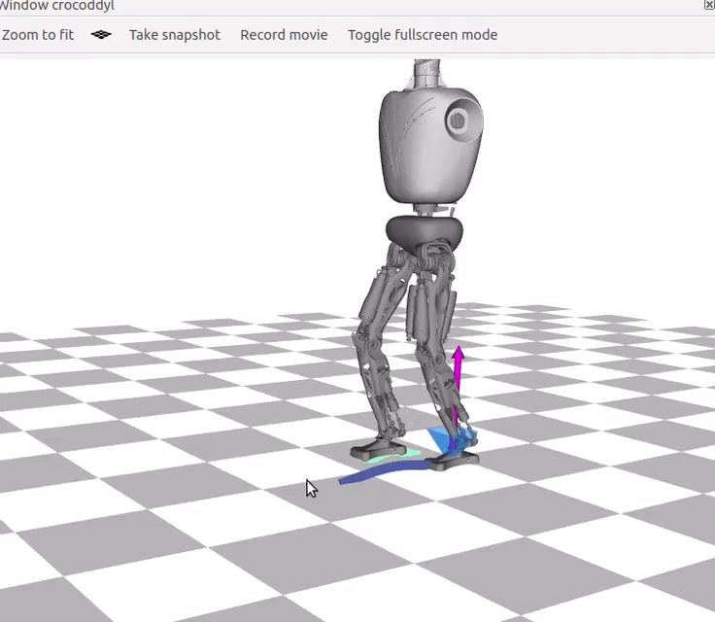
RH5 Analysis: Stabilizing the Torso

Slide 18
Lessons Learned
With Crocoddyl
Installation through robotpkg manager (not from source)
Still under development
With RH5
Basic walking patterns worked
Range of motion seems useful
Further Investigations
Real world: First (offline computed) experiments
Simulation: Towards highly dynamic movements

Slide 19
Related Links
Project Documentation:
https://github.com/julesser/oc-frameworks
RH5 Results:
https://github.com/julesser/crocoddyl/tree/devel/examples
RH5 Models:
https://git.hb.dfki.de/jesser/abstract-urdf
Crocoddyl Paper:
https://arxiv.org/pdf/1909.04947.pdf
Crocoddyl Video:
https://www.youtube.com/watch?v=wHy8YAHwj-M
Bipedal Walking with the Talos Robot:
https://hal.archives-ouvertes.fr/hal-02383130/document

